Slide 1
Migration to Cloud for Smaller Enterprise Businesses
By
Andrew Abbott
Nathan Mowat
Tracie Scott

Slide 2
What is cloud computing?
Any service provided over the Internet
Buying a book on Amazon
-vs-
Using AWS to host web services

Slide 3
What is cloud computing?
The on-demand delivery of compute power, database storage, applications, and other IT resources through a cloud services platform via the Internet with pay-as-you-go pricing.
Characterized by
Self-service provisioning Elasticity
Pay per Use (Measured Services) Workload resilience
Migration Flexibility Resource Pooling
Notes:
Source
Overview of Amazon Web Services 2017
What’s interesting is that cloud computing is defined as much by it’s key characteristics as by the unique technologies or architectures that enable the service.

Slide 4
Do the math. Does cloud add up for you?
+ Cost
+ CapEx vs OpEx
+ Speed to provision
+ Specialty skills
+ Allows focus on core business
+ Simplicity
+ Latest technology
+ Global deployment made easy
Cost, especially unexpected costs
Fear of Lock-in
Loss of control
Fear of the unknown, esp regarding security
Lagging technology
Inadequate SLA

Slide 5
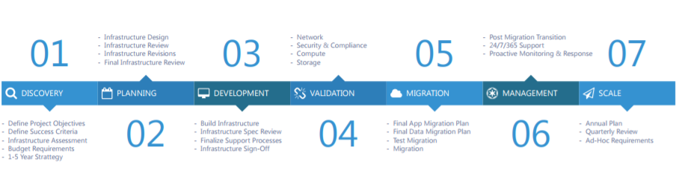
Migration Approach*
Incomplete Inventory
Failure to establish leadership
Upgrading part of the stack
Failure to engage the business
Inaccurate estimates for data migration duration
Set it and Forget it
We’re done!
Notes:
https://go.servercentral.com/hubfs/PDFs/The_Successful_Data_Center_Migration-A_ServerCentral_White_Paper.pdf?t=1492801095460

Slide 6
Migration is a series of efforts
Inventory Needs by workload
Business Applications like ERP, HCM, or CRM
Productivity applications like Windows business applications
HelpDesk services
Analytics
Development Operations
Infrastructure like DNS and SSO
Scalable resources for peak use period
Prioritize and make a plan for each
Applications that are harder to migrate
Proprietary or heavily customized applications
Legacy applications
Uncommon, special purpose- applications with unique requirements

Slide 7
Map workloads to the right type of provider
Types of Cloud Services
Examples
Software as a Service (SaaS)
Platform as a Service (PaaS)
Infrastructure as a Service (IaaS)
NetSuite
Salesforce for CRM
Office360 for productivity
Salesforce or Service Now for helpdesk
Amazon RDS
Amazon S3, Amazon EC2
Notes:
Most applications have some sort of SaaS provider available, so most of your migration will be from an on-prem version to a SaaS option.
Look for an opportunity to spin up SaaS offerings at ‘natural’ intervals when licenses expire or applications are retired.
Many vendors now do the on-prem to cloud migration free for their existing customers to prevent churn.
Some workloads will require an Infrastructure or platform provider.
There are four major players in this field, which Amazon Web Services (AWS) being by far the industry leader.
AWS is generally considered the ‘safe’ choice for most workloads.
Azure is growing in popularity among companies who use Microsoft product and
Google is a relatively new offering targeted toward application developers. Ultimately, you could use all three given the right mix of requirements.
IBM cloud offerings tend to be used by larger Enterprises who are already using IBM managed services.

Slide 8
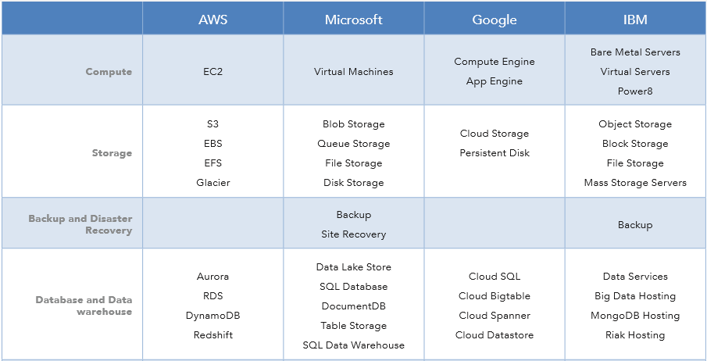
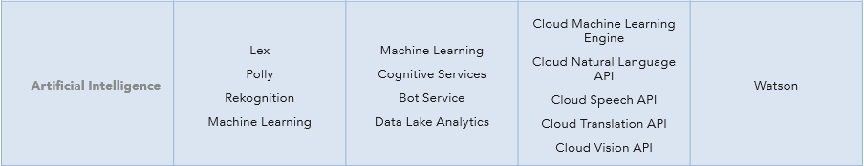
Top four infrastructure and platform providers offer a range of services with similar pricing strategies.
IBM is not a typical choice for smaller enterprise organizations.
Notes:
AWS is by far the leader with ¾ of all public cloud IaaS and PaaS implementation. They provide generalized services with a growing list of workloads and are
Used by broadest customer set for broad set of requirements
Azure by Microsoft – appeals to Enterprises that heavily rely on Microsoft products
Google- large volumes of data and applications with a massive scale;
recommended for big data applications and batch computing and for developers who are building cloud-native apps
Strategic support of the hybrid deployment model is well-suited to the variety of cloud migration strategies used by IBM customers
Watson integration makes Bluemix a particularly good choice for developers looking for artificial intelligence or analytics capabilities

Slide 9
Major costs associated with IaaS and PaaS
What drives costs
Sources of “Wasted spend”
Compute costs - 60% or more of your total subscription
Bandwidth – as much as 20%
Rewriting apps - cost often overlooked; “…you will end up writing an app that looks nothing like the app on-prem..”
Storage – disk, flash, memory
Support
Over-Provisioning
Under-Provisioning
Fire and Forget
Bad storage choices – too much or too little of the wrong type
Add on services - unnecessary load balancers and VPNs
Exit Fees
Notes:
Compute costs - 60% or more of your total subscription
Bandwidth – as much as 20%
Rewriting apps - cost often overlooked; “…you will end up writing an app that looks nothing like the app on-prem..”
Storage – disk, flash, memory
Support
Over-Provisioning
Under-Provisioning
Fire and Forget
Bad storage choices – too much or too little of the wrong type
Add on services - unnecessary load balancers and VPNs
Exit Fees

Slide 10
Data Migration Options
Data Migration
Forklift Strategy
Data only, no applications
Tier 3 apps, Latency sensitive, entire Application, including data servers and web services
Machine Replication
Disaster Recovery
Tier 1 & 2 apps, Replicate entire stack. Portability due to VMware-based technology
Replicate entire system for Failover if the first system goes down
P2V Migration
Physical-to-virtual: physical server to VM
Notes:
Data migration is a key element of workload migration strategy. Storage is a key driver of cost and often data backup solutions are some of the first forays into cloud computing. Data has ‘gravity’, meaning it’s not as easily moved as compute and networking as data can require significant resources to move or copy from on-premise to cloud. Thus, planning this step for each workload is crucial.

Slide 11
Migration Services: CloudEndure
Installation
Install CloudEndure Agent onto machine
Selection
Point Agent to new cloud service
Replication
Continuous background replication of data to new location
Testing
Cutover
Verify integrity of data/application migration
Point users to new cloud server and “cutsoff” from old

Slide 12
Data Migration Requirements
< 1 TB
0-30 hours via Standard 100Mbps connection
Online transfer still viable
1 TB – 30 TB
1-36 days via online transfer - OR
Store in NAS appliances and ship to cloud provider
30 TB – 1 PB+
Up to 3 years via online transfer - OR
AWS Snowball or Google Transfer Appliance
https://cloudplatform.googleblog.com/2017/07/introducing-Transfer-Appliance-Sneakernet-for-the-cloud-era.html

Slide 13
Summary
Leverage discovery tools, migration planners, and cost calculators supplied by the major providers
Plan by workload
Approach as a series of efforts over time to build competence
Provisioning resources for peak usage or short-term projects
Start with non-mission critical needs to build knowledge and skill
Pick the right platform for each workload
Understand compute, network, and storage characteristics of each workload
If migrating a proprietary application, research costs associated with cloud rewrite
Plan the data migration
Control downtime

